Slide 1
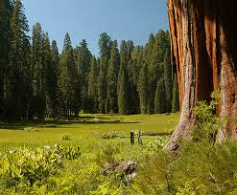
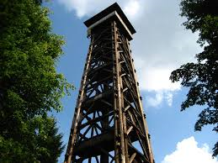
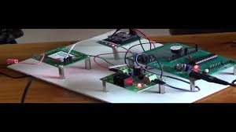
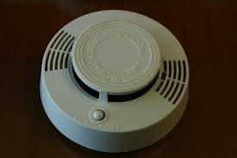
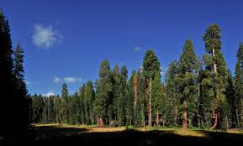
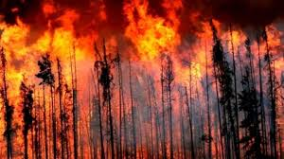
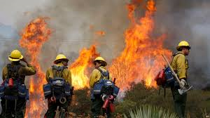
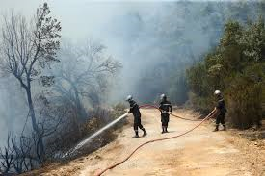
Forests savior
Abstract :
As we know , sometimes the forests get burned . And this caused by 2 reasons , natural reasons and human reasons .
The natural reasons are the reasons that can’t be predicted as it’s caused by nature , on the other hand the human reasons are the reasons that can be predicted as it’s caused because of many reasons .
So our project is depending on how to predict the time of burning the forests , and how to reduce the damages that will be caused because of forest fires .
Introduction :
As we mentioned above , our project is how to predict the forest fire and how to reduce the damages of the forest fires .
if we give an example , the California forest is one of the most forests that suffers from forests fires . It’s area is 423,970 (430000 km2) . It’s width is 440 km. it’s length is1240 km . About 9093 fires had occurred in Californian . This cost the country About 2.681 billion dollars .
The methods and materials :
Analysis :
The project is based on how to predict the forests fires , and how to control the fires that happen in forests .
The idea is to put a thermal sensors on a tower to predict if there is any changes in the weather or the temperature .
When there is a change in the temperature and it’s increasing the sensors will predict and senses about fires then will send to the alarm which will work by solar, wind and hydro power then alarm will ring.
When fires increase the sensor where upper alarm will sense the ring of alarm will increase.
We will but alarm out side the forest to tell the people that fires happen now, at the same time it will tell the fire center to Extinguish the fire .
And the alarm which will we but it in tower will tell people who exists inside the forest
Recommendation
1.
Thermal sensor
Tower
Literature cited
https://en.wikipedia.org/wiki/Wildfire
https://www.electronics-tutorials.ws/io/io_3.html
alarm
The results :
if the project will be done on the real life , this would help in predicting the fires and control them very well . This project also will save people’s life , besides it will reduce the percentage of fires that happen in California region . The ecosystems that are lived in the forests will not be destroyed , and it may mushrooms . The forests that will be saved , would be a sightseeing for many tourists .
For further information
ahmedkonn80@gmail.com
Sara.abdelrahman@stemksheikh.moe.edu.eg
Rawan.20973@stemksheikh.moe.edu.eg\
Notes:
This poster template is from http://www.swarthmore.edu/NatSci/cpurrin1/posteradvice.htm. It is free, free, free for non-commercial use. But if you really like it, I’m always thrilled to get postcards from wherever you happen to be presenting your poster. Or, send me cookies! My kids made me put that last sentence in. Have fun. Sincerely, Colin Purrington, Department of Biology, Swarthmore College, Swarthmore, PA 19081, USA. Email: cpurrin1@swarthmore.edu

